Slide 1
An Introduction to Algorithmic Combinatorial Game Theory
Zhujun Zhang（张诸俊）
2024.6.7, Guangzhou Discrete Mathematics Seminar

Slide 2
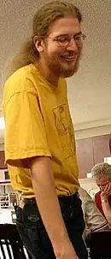
The term “Algorithmic Combinatorial Game Theory”
Erik D. Demaine, Robert A. Hearn, 2001
Paper: Playing Games with Algorithms: Algorithmic Combinatorial Game Theory
Survey results about the complexity of determining ideal play in combinatorial games, and the related problems of solving puzzles, in terms of both polynomial-time algorithms and computational intractability results.
Book: Games, puzzles and computation, 2009

Slide 3
Contents
1 Combinatorial Game Theory
2 Computational Complexity
3 Complexity of Atropos

Slide 4
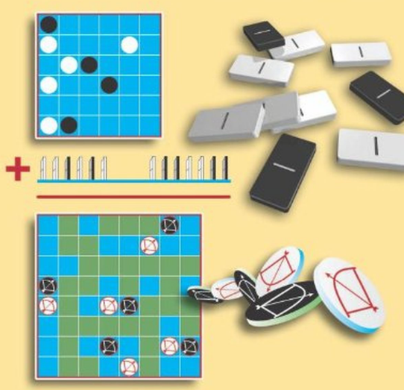
1 Combinatorial Game Theory
definition of Combinatorial Game
features：
two-player game
play alternately
no random (chance) elements
no hidden information

Slide 5
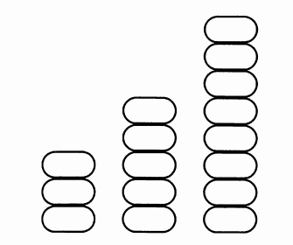
Nim
several heaps of stones
each turn a player may remove any number of stones (at least one) from any one heap
removes the last stone(s) wins
XOR algorithm (Bouton's Theorem):
3 XOR 5 XOR 8 =
11 XOR 101 XOR 1000 = 1110 ≠ 0
so the player to remove has a forced win

Slide 6
Classic board games
Go (围棋)
Chess (国际象棋)
Xiangqi (Chinese Chess) (中国象棋)
Gobang (Gomoku) (五子棋)
Othello (Reversi) (黑白棋)
Checkers (国际跳棋)

Slide 7
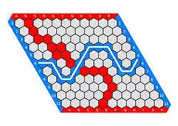
Hex （六贯棋）
Each player is assigned a pair of opposite sides of the board which they must try to connect by taking turns placing a stone of their color onto any empty space. A player wins when they successfully connect their sides together through a chain of adjacent stones.

Slide 8
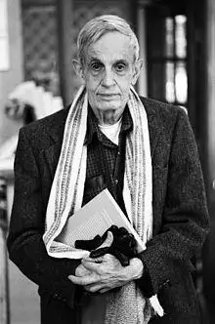
Hex
The game can NOT end in a draw by John Nash (1949).
It is equivalent to the Brouwer fixed-point theorem, see [David Gale (1979). "The Game of Hex and Brouwer Fixed-Point Theorem". The American Mathematical Monthly. Mathematical Association of America. 86 (10): 818–827.]
And the first player has a forced win by strategy-stealing!

Slide 9
Theory of CGT
Zermelo Theorem (策梅洛定理)
for every short game: either the first or second player has a forced win
short: positions and runs are finite.
Sprague-Grundy Theory
for every short impartial games: equal to a nim-heap
impartial (无偏的): both players have the same moves available at all times.

Slide 10
Theory of CGT
Winning Ways for Your Mathematical Plays (1982)
by Elwyn R. Berlekamp John H. Conway Richard K. Guy
Surreal Numbers (1976)
by John H. Conway
Mathematical Go: Chilling Gets the Last Point (1994)
by Elwyn R. Berlekamp, David Wolfe

Slide 11
Solve games
Strong solve (强解决): Provide an algorithm that can produce perfect moves from any position. ---- Example: Nim
Weak solve (弱解决): Provide an algorithm that secures a win for one player, or a draw for either, against any possible moves by the opponent, from the beginning of the game.
Ultra-weak solve (超弱解决): Prove whether the first player will win, lose or draw from the initial position, given perfect play on both sides. This can be a non-constructive proof (possibly involving a strategy-stealing argument) that need not actually determine any moves of the perfect play. ---- Example: Hex

Slide 12
Weak-solved classic board games
Gobang (Gomoku) ---- Black has a Forced Win (in about 1900 by artificial computation). [L. Victor Allis (1994). Searching for Solutions in Games and Artificial Intelligence. Ph.D. thesis, University of Limburg, The Netherlands.]
The rules are changed.
Checkers ---- Perfect play leads to a Draw, by search 5*10^20 positions, see [Schaeffer, Jonathan, et al. "Checkers Is Solved." Science 317.5844(2007):1518-1522.]
The board is enlarged from 8*8 to 10*10.
Othello (Reversi) ---- Draw ?
[Hiroki Takizawa, Othello is Solved, arXiv:2310.19387.] (by search about 10^28 positions)

Slide 13
2 Computational Complexity
Computational complexity theory
---- an investigation of the time, memory, or other resources required for solving computational problems.

Slide 14
Computational Complexity Classes
P: problems could be solved within polynomial time
NP: a candidate solution could be verified within polynomial time
PSPACE: problems could be solved within polynomial space
EXPTIME: problems could be solved within exponential time
EXPSPACE: problems could be solved within exponential space
P ⊆ NP ⊆ PSPACE ⊆ EXPTIME ⊆ EXPSPACE ...

Slide 15
Hierarchy theorem (层次定理)
P ≠ EXPTIME PSPACE ≠ EXPSPACE
P ⊆ NP ⊆ PSPACE ⊆ EXPTIME ⊆ EXPSPACE ...
At least one of the first three“⊆”is (are)“⊂”.
The most famous open problem in computer science:
P vs NP

Slide 16
Reduction
Reduction (归约): If for every instance x of problem A, we can construct a instance y of problem B, satisfy that the answer of x is yes iff the answer of y is yes, then A is reducible to B.
Efficient reduction: polynomial time
Transitivity: If problem A can be reduced to problem B, and problem B can be reduced to problem C, then A can be reduced to C.
instance of A
reduction
instance of B
algorithm for A
algorithm for B

Slide 17
Complete Theory
X-hard: If every problem in X can be reduced to problem A, then A is X-hard.
X-complete: If a problem A is in X, and A is X-hard, then A is X-complete.
X = P, NP, PSPACE ...
Example: NP-complete
If we find a polynomial time algorithm for a NP-complete problem, then P=NP !

Slide 18
Overview of Computational Complexity Classes (hypothesis)
EXPTIME
PSPACE
NP
P
NP-complete
PSPACE-complete
EXPTIME-complete

Slide 19
Complete problems
Cook-Levin Theorem (1971): SAT is NP-complete.
SAT: determine whether a Boolean formula is satisfiable
Example: x∧(y∨x) ∧z
Theorem: TQBF is PSPACE-complete.
TQBF: determine whether a quantified Boolean formula is true or false
Example: ∃x∀y∃z [ x∧(y∨x) ∧z ]

Slide 20
Complete problems web
Karp’s 21 NP-complete problems.
A reduction tree.

Slide 21
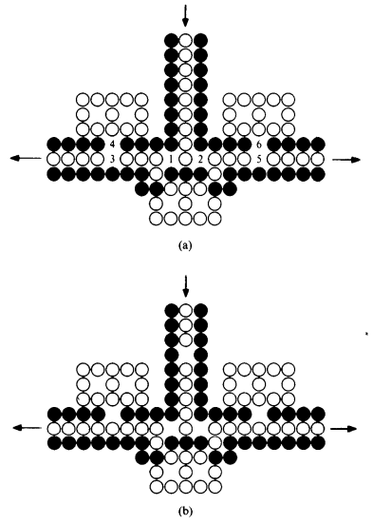
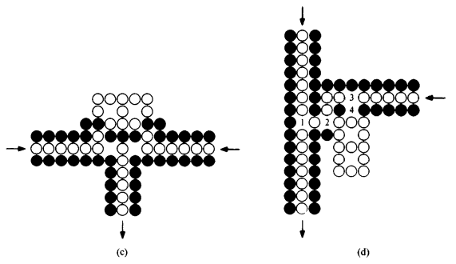
Computational complexity of board games
Go is PSPACE-hard.
[David Lichtenstein and Michael Sipser. Go is polynomial-space hard. Journal of the ACM (JACM), 27(2):393–401, 1980]

Slide 22
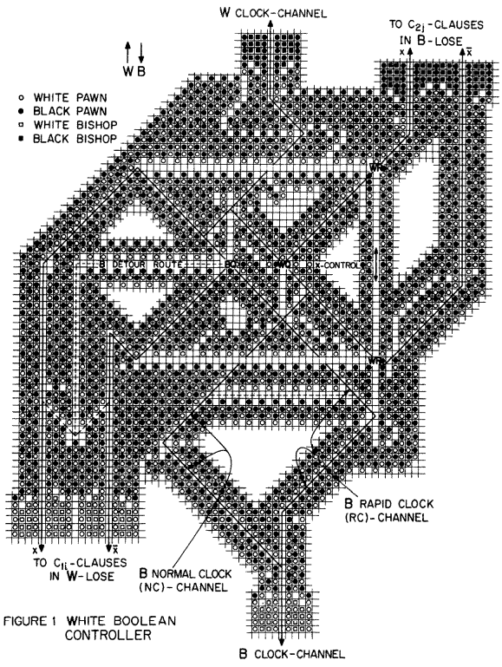
Computational complexity of board games
Chess is EXPTIME-complete.
[Aviezri S Fraenkel and David Lichtenstein. Computing a perfect strategy for n chess requires time exponential in n. In International Colloquium on Automata, Languages, and Programming, pages 278–293. Springer, 1981. ]

Slide 23
Computational complexity of board games
Gobang, Hex, and Othello are PSPACE-complete.
[Stefan Reisch. Gobang ist PSPACE-vollständig. Acta Informatica, 13(1):59–66, 1980. ]
[Reisch S .Hex is PSPACE-complete.Acta Informatica, 1981, 15(2):167-191.]
[Shigeki Iwata and Takumi Kasai. The Othello game on an n × n board is PSPACE-complete. Theoretical Computer Science, 123(2):329–340, 1994. ]

Slide 24
Computational complexity of board games
Checkers and Shogi (日本将棋) are EXPTIME-complete.
[John Michael Robson. N by N checkers is Exptime complete. SIAM Journal on Computing, 13(2):252–267, 1984. ]
[Hiroyuki Adachi, Hiroyuki Kamekawa, and Shigeki Iwata. Shogi on n × n board is complete in exponential time. Trans. IEICE, 70:1843–1852, 1987. ]

Slide 25
Computational complexity of games

Slide 26
Open problems on complexity of games
Domineering is PSPACE-complete?
Go with super-ko rule (禁全同规则的围棋) is EXPSPACE-complete?
Chinese Checkers (中国跳棋) is EXPTIME-complete?
Phutball (哲球棋) is PSPACE-hard, but is EXPTIME-complete?
Arimaa (印度斗兽棋) is PSPACE-hard, but is EXPTIME-complete?

Slide 27
3 Complexity of Atropos
Kyle W. Burke and Shang-Hua Teng introduced a two-player combinatorial game Atropos based on Sperner’s lemma, and showed that deciding whether one has a winning strategy for Atropos is PSPACE-complete.
[K. W. Burke, S.-H. Teng, Atropos: A PSPACE-complete Sperner triangle game, Internet Mathematics 5 (4) (2008) 477–492]

Slide 28
Complexity of Atropos
In the original Atropos game, the players must color a node adjacent to the last colored node. Burke and Teng also mentioned a variant Atropos-k in which each move is at most of distance k of the previous move, and asked a question on determining the computational complexity of this variant.
We answer this question by showing that for any fixed integer k (k ≥ 2), Atropos-k is PSPACE-complete.
This is joint work with Chao Yang (杨超).
[Atropos-k is PSPACE-complete. arXiv:2403.01662]

Slide 29
Atropos and Sperner’s lemma
Two players take turns to color the inner nodes in one of the three colors: red, green, and blue.
If a player creates a rainbow triangle (i.e. a triangle that receives three different colors in its three nodes), she or he loses the game.
According to Sperner’s Lemma,
the game can NOT end in a
draw, just like Hex!

Slide 30
Atropos is PSPACE-complete
To prove PSPACE-hardness, Burke and Teng reduced Generalized Geography to Atropos.
In their proof, a single path is used to simulate the process of assigning true or false to each Boolean variable.
To settle the computational complexity of Atropos-k, we use two paths for the simulation of the assignment of true or false.
We consider k=2 firstly, then generalize to any fixed k.

Slide 31
Generalized Geography
Geography is a game in which players take turns naming cities. Each city chosen must begin with the same letter that ended the previous city’s name. Repetition is not permitted.

Slide 32
Generalized Geography
Use Generalized Geography to simulate the formula game
TQBF which is PSPACE-complete.

Slide 33
Overview of the reduction
The overall reduction consists of two parts.
The first part is in the area enclosed by the red lines. Two players take turns to assign a truth value to each variable of the formula.
The second part is outside the red dashed lines, where the two players decide to check the truth value of a particular literal of a particular clause.

Slide 34
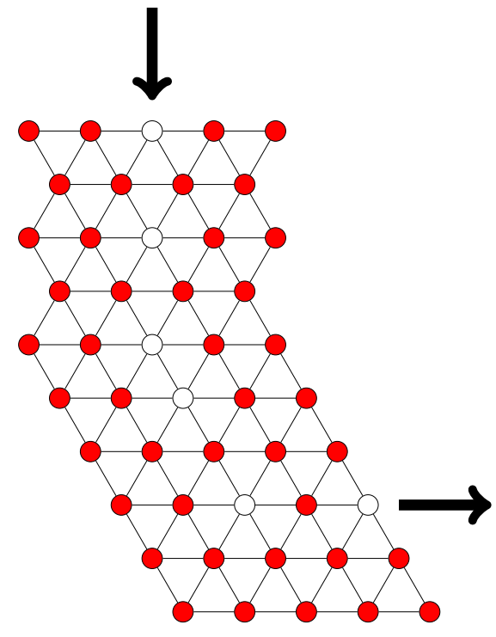
Gadgets
path gadget
start gadget

Slide 35
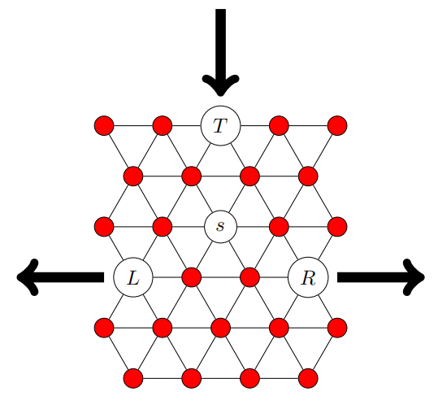
Gadgets
switch gadget
merge gadget

Slide 36
Gadgets
check gadget

Slide 37
Crossover gadget

Slide 38
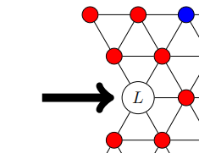
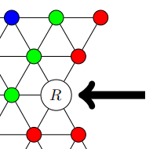
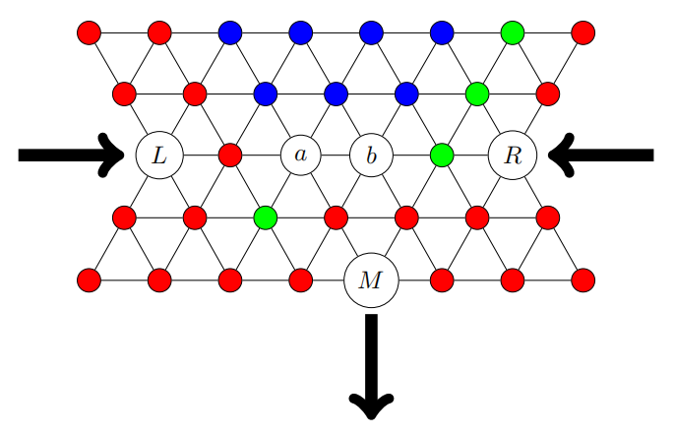
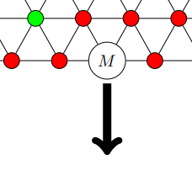
To any fixed integer k
distance
k
distance
k
distance k
Modify the gadgets so that the distance between two consecutive uncolored nodes is k.

Slide 39
Thanks for your attention.

